Slide 1

Lecture 4 – Porous Materials Property Predictions from Features
김지한 (카이스트)
8.20.2021

Slide 2
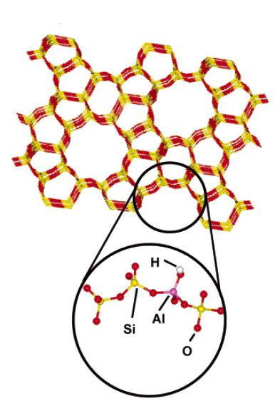
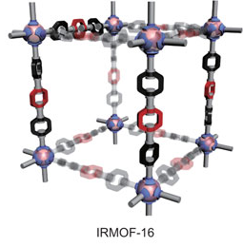
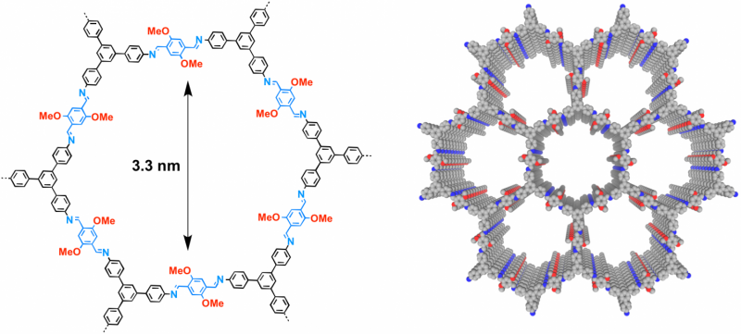
Revisiting the Porous Materials
In Lecture 3, we talked about porous materials and how they can be valuable for many different applications.
Zeolites
Nanoporous materials: contain pores on the order of few Angstroms to nanometers.
Different classes of materials exist: zeolites, MOFs, COFs, etc.
Large surface area and high tunability.
Metal-organic frameworks
(MOFs)
Covalent organic frameworks (COFs)

Slide 3
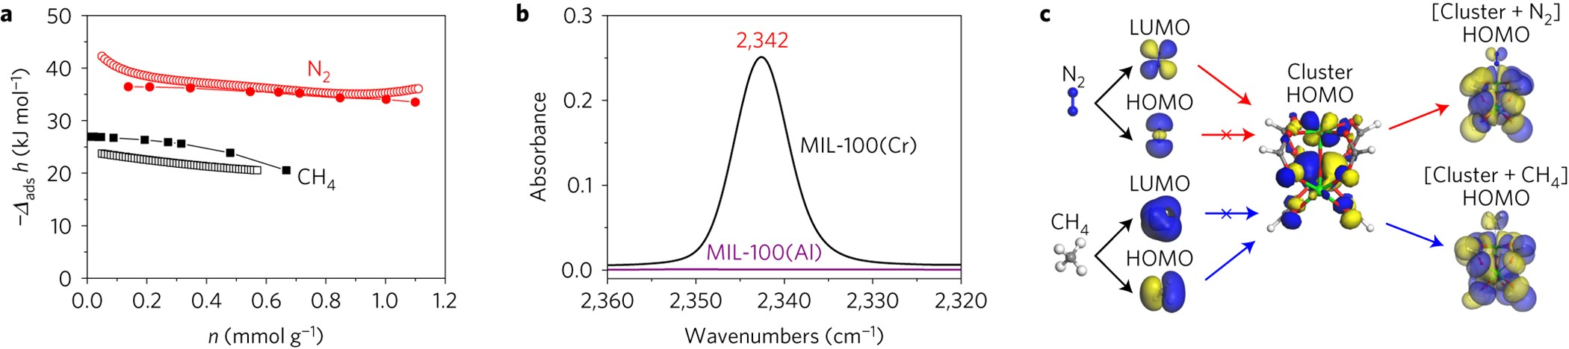
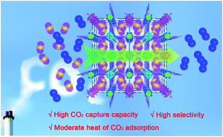
Pores – Importance for Material Properties
Chemical Properties
Size Selectivity

Slide 4
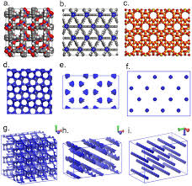
Geometrical Analysis of Pores
One simple analysis we can do for a given porous material is to conduct geometric analysis of the pores.
Geometrical analysis gives us list of reliable and important features especially when we care mostly about physisorption (as opposed to chemisorption) within the materials.

Slide 5
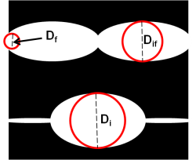
Zeo++
Zeo++ is a software that one can use to analyze geometry of the pores.
http://zeoplusplus.org/
Using Zeo++, you can obtain basic properties (e.g. unit cell size, framework density, type of atoms) as well as some of the unique properties that pertain to geometrical analysis (see example below).

Slide 6
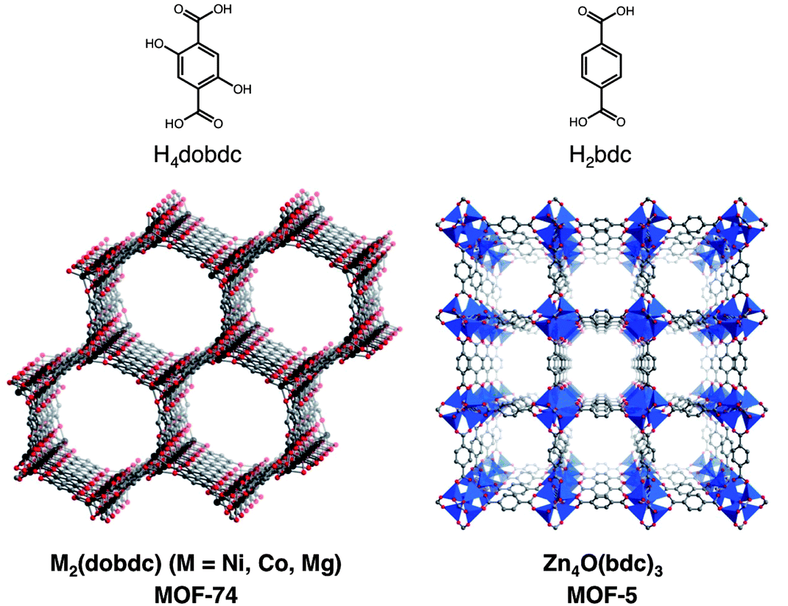
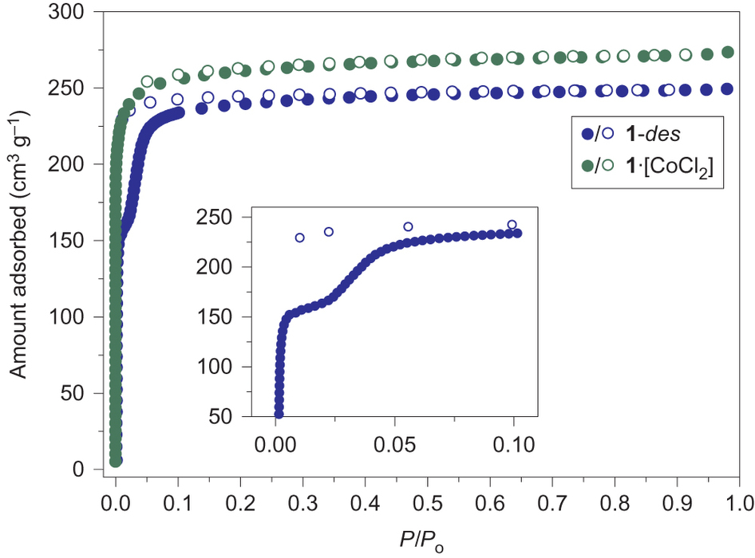
Zeo++: Pore Volume
Pore volume tells us how much “void space” that there are in these materials.
Conventionally, pore volume is experimentally measured with N₂ isotherm at T = 77 K.
Usually, pore volume is reported in units of cm³/g.

Slide 7
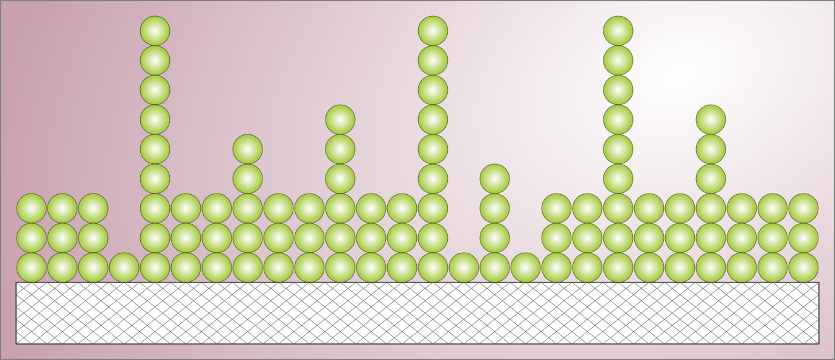
Zeo++: Surface Area
Surface area of porous materials tells us how much area is available for gas molecules to adsorb.
Depending on the level of theory, the most popular measurements of surface area are Langmuir (monolayer) and BET (multi-layer) adsorption.
The units are usually in m²/g.

Slide 8
Zeo++ Download and Compile
http://www.maciejharanczyk.info/Zeopp/download.html
The tar file can be unzipped from Dirac: $ tar –xvf zeo++ -0.2.2.tar
Compile the Voro++ library: $cd zeo++ -0.2.2/voro++/src
$make
Compile the Zeo++ code: $cd ../..
$make

Slide 9
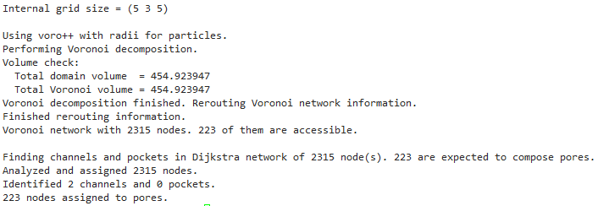
Zeo++ Execution
Now that Zeo++ is compiled, we can take an input file of any porous material and obtain the geometric properties.
E.g.
$ ./network –ha –vol 1.2 1.2 50000 ABW.cssr
The details behind Zeo++ can be read from the online manual.

Slide 10
Zeo++ Output File
Upon running Zeo++, you will get a typical output value that looks as follows.
E.g. Unitcell_volume: volume of the unit cell
Density: framework density
AV_A^3: available pore volume (in Angstroms^3)
AV_Volume_fraction: available pore volume in fraction (0 to 1)
NAV_A^3: non-available pore volume (in Angstroms^3)
Number_of_channels: number of channels in unit cell
Etc.

Slide 11
Zeo++ Output File: Aggregates
structure | Density | AV_Volume_fraction | AV_cm^3/g | ASA_m^2/cm^3 | ASA_m^2/g | NASA_m^2/cm^3 | NASA_m^2/g | Di | Df | Dif
abf+N32+N411+N76+E153+E183+E51 | 0.162743 | 0.81944 | 5.03517 | 866.981 | 5327.29 | 0 | 0 | 28.41027 | 21.85151 | 28.41027
abf+N89+N408+N276+E26+E20+E195 | 0.120592 | 0.8191 | 6.7923 | 916.295 | 7598.28 | 0 | 0 | 27.61805 | 20.14127 | 27.61805
abr+N52+N129+N256+E25+E169+E41 | 0.153105 | 0.83148 | 5.43077 | 844.605 | 5516.5 | 0 | 0 | 36.95451 | 32.83737 | 36.95451
abr+N190+N434+N164+E50+E69+E25 | 0.56139 | 0.46228 | 0.823456 | 2218.2 | 3951.26 | 0.050653 | 0.0902278 | 13.2257 | 8.71424 | 12.25306

Slide 12
Zeo++ vs Simulation (Classical GCMC/Quantum)
The great thing about Zeo++ is that it is very fast (just few seconds to get all this data for a given material).
Comparatively, getting useful properties using classical simulations can last for hours and with quantum calculations, it might take days.
So then, we can think about running a lot of Zeo++ simulations for thousands of materials and using these features (e.g. density, available pore volume, surface area) to see whether we can predict various materials properties.
Target | Feature 1 | Feature 2 | Feature 3 | Feature 4 | Feature 5
Price of car | Mileage | Age | Brand | Condition | Country
Methane Uptake | Framework Density | AV | ASA | Di | Df

Slide 13
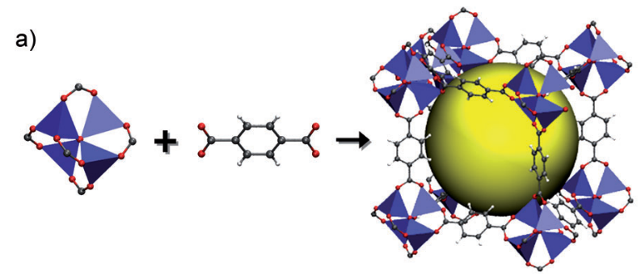
Different Representation of Porous Materials
Let’s say that we want to select different set of features for the porous materials.
Instead of using geometrical properties from Zeo++, we want to dissect the porous materials (in this case MOFs) into its constituents.
Namely,
Metal cluster
Organic linker
MOF

Slide 14
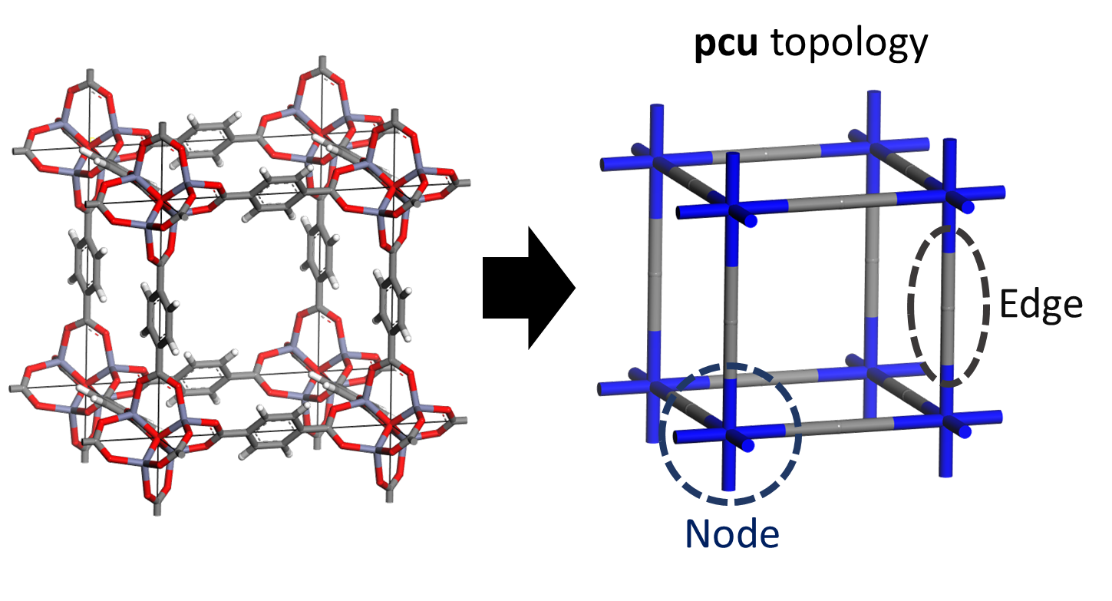
Topology for Different MOFs
The unit cell of each of these MOFs can be abstracted into known mathematical topologies. Example

Slide 15
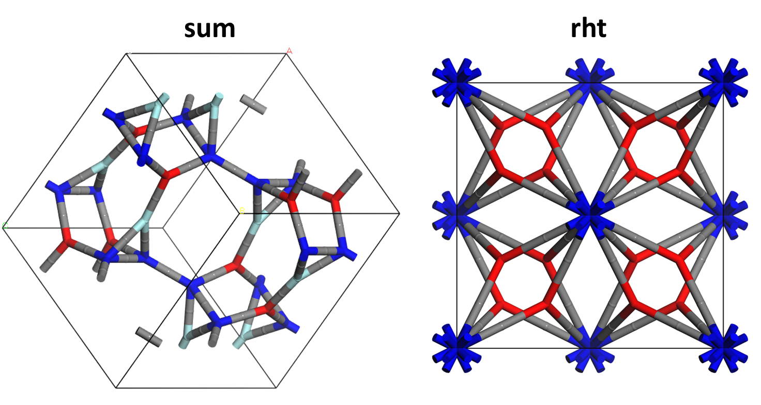
Topology for Different MOFs
There are more than 3000 topologies reported in the RCSR database.

Slide 16
Representation for MOFs
In trying to infer target properties, we initially imposed geometric features of the materials.
We can now look at this from a more “fundamental” representation of the MOFs by using the consitutient parts as features.
Now, let’s discuss briefly about “methane uptake”
Target | Feature 1 | Feature 2 | Feature 3 | Feature 4 | Feature 5
Methane Uptake | Framework Density | AV | ASA | Di | Df
Target | Feature 1 | Feature 2 | Feature 3
Methane Uptake | Node | Edge | Topology

Slide 17
Methane Uptake
The quantity that we are targeting and fitting is methane uptake
Need a material that is at least 315 cm³/cm³
Uptake (cm³/cm³)
5.8
65
Pressure (bar)

Slide 18
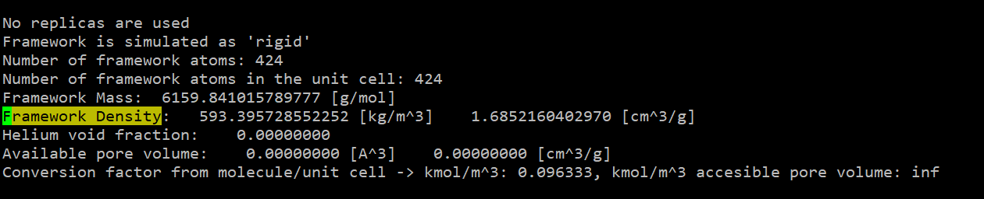
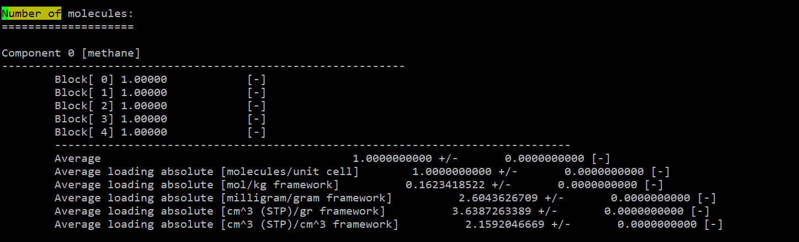
MOF Methane Uptake: GCMC Approach
In practice, we can use GCMC simulations (RASPA) to obtain the methane uptake (~10 minutes per material).
But let’s say that we have millions of materials and we want to go through all of them. The total wall time would be 10 minutes * 1,000,000 = 10,000,000 minutes = 6944 days = 19 years!!
If we have 8 computers dedicated to this project, it would still be over 2 years.

Slide 19
MOF Methane Uptake: Machine Learning Approach
Let’s say instead, we use a machine learning approach.
To train our model, we still need to conduct GCMC simulations to obtain the labeled data set.
But let’s say we can just do 20,000 materials and that would be sufficient.
The total wall time for GCMC would be 10 minutes * 20,000 = 200,000 minutes = 138 days
If we have 8 computers dedicated to this project, it would take 17 days (~3 weeks) to get this data.
Much more reasonable!!

Slide 20
MOF Methane Uptake: Machine Learning Approach
However, we have to add in the cost of running (1) Zeo++ simulations and/or (2) dividing the MOFs into node/edge/topology.
And remember, we need to do this for all the MOFs.
It turns out that both of these approaches can be done far faster than GCMC simulations.
E.g. Zeo++ takes about 10 seconds to get output.
Preparing all million MOFs for Zeo++: 10 second * 1,000,000 = 10,000,000 seconds = 116 days.
With 8 computers, we can prepare all the features in 14 days.
Brute force GCMC simulations for 1 million materials: 2+ year
Machine Learning Approach: 17 days (20,000 GCMC) + 14 days (Zeo++) + C
where C is time it takes to train the neural network/machine learning model and run the model to get results. Seems to be much faster!!

